Slide 1
Recommendation Systems
Market Basket Analysis And Product Recommender using Vector DB
Rajeev Sharma

Slide 2
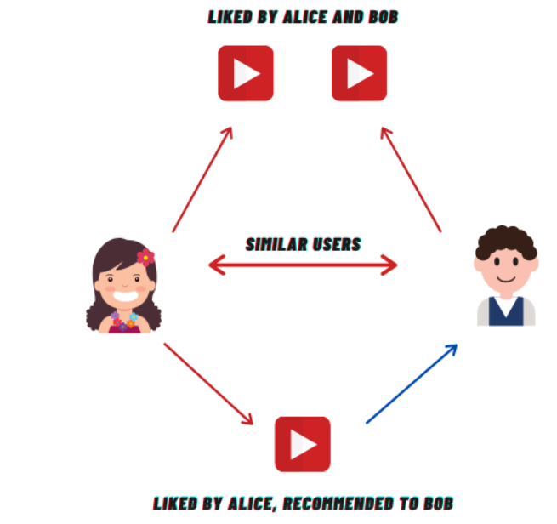
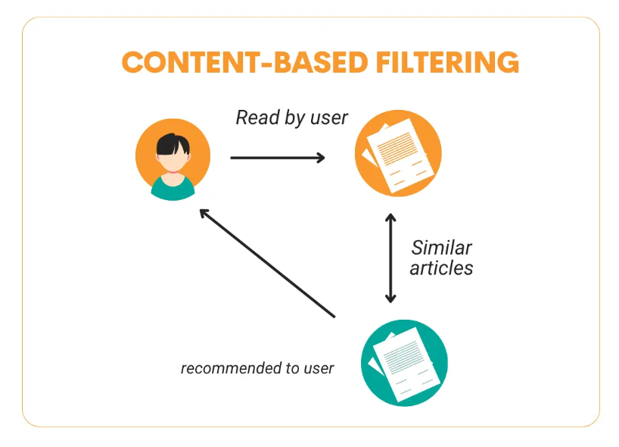
Recommendation Systems Types
Collaborative Filtering: A method that makes automatic
predictions about the interests of a user by collecting
preferences from many users (collaborating).
○ User-based
○ Item-based
Content-Based Filtering: A technique that recommends items
by comparing the content of the items and a user profile, with
content described in terms of several descriptors that are
inherent to the item
○ a book might be described by its author, its publisher, etc.
Hybrid Systems: A system that combines various
recommendation approaches to enhance prediction accuracy.
○ Netflix’s recommendation system, which uses a mix of
collaborative and content-based filtering.
Credit: Introduction to Collaborative Filtering-Analytics Vidhya
Credit: Step-by-Step Guide to Building
Content-Based Filtering - StrataScratch

Slide 3

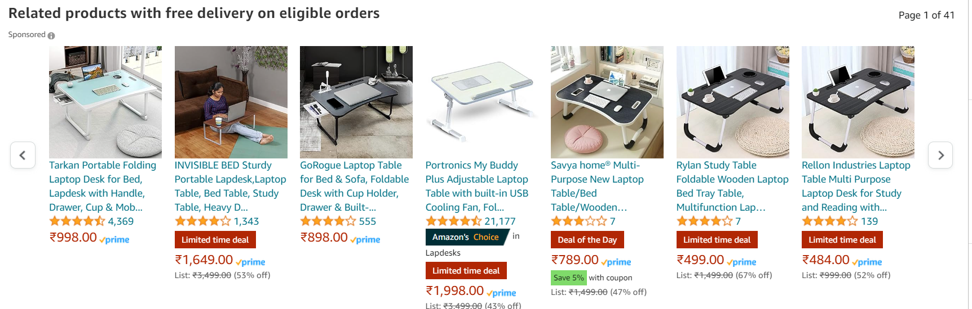
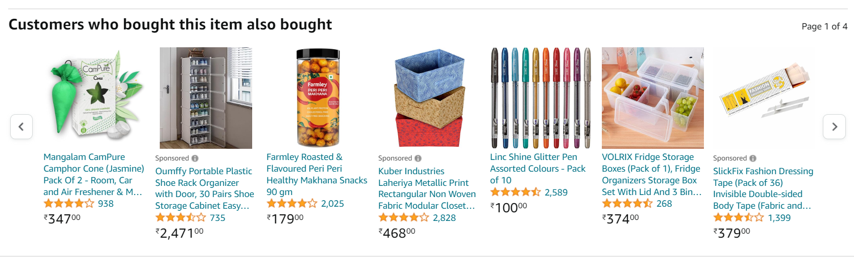
Examples of Rec Sys
Suppose we are looking for study table
on Amazon
Content based filtering
Collaborative filtering

Slide 4
Merits and Demerits of Collaborative Filtering
Merits | Demerits
No domain knowledge needed | Cold start problem -can’t handle new data
Personalized to users | Sparsity -Unable to compute ratings if there are a very less number of user preferences
Adaptive to the preferences changes over time | Scalability -Computationally expensive to scale

Slide 5
Merits and Demerits of Content Based Filtering
Merits | Demerits
Does not require lot of user data | Unavailability of features which explain Items and user preferences
Does not suffer from cold start | Recommendations will likely be direct substitutes, and not complements, of the item the user interacted with.
Less expensive to build and maintain | Less dynamic

Slide 6
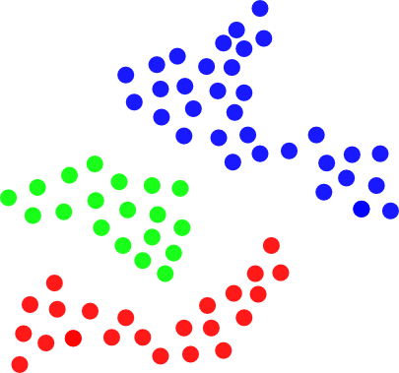
Clustering based recommendation systems
Unsupervised methods (clustering) to build recommendation systems.
Each cluster would be assigned to typical preferences, based on preferences of customers who belong to the cluster.
Customers within each cluster would receive recommendations computed at the cluster level.
Methodology:
Compute similarity between each pair of users
Obtain representation of each user in low dimensional space
Perform the k means clustering algorithm and find the k number of clusters
The image shows clusters of users who have
similar preferences so that they will receive the same
product recommendations

Slide 7
Matrix Factorization (SVD)
Sparsity and scalability can be the biggest two challenges with Collaborative Filtering methods
Matrix Factorization decomposes the original sparse matrix to low dimensional matrices with latent features and less sparsity.
It gives us how much a user is aligned with a set of latent features, and how much an item fits into this set of latent features
It uses Singular Value Decomposition to factorize the matrix. For a user- items n × m matrix, it is given by:
A=U∑V^{T}
U is an n× k user latent feature matrix,
V is an m × k item latent feature matrix
Σ is an k × k diagonal matrix containing the singular values of original matrix
representing how important a specific feature is to predict user preference.

Slide 8
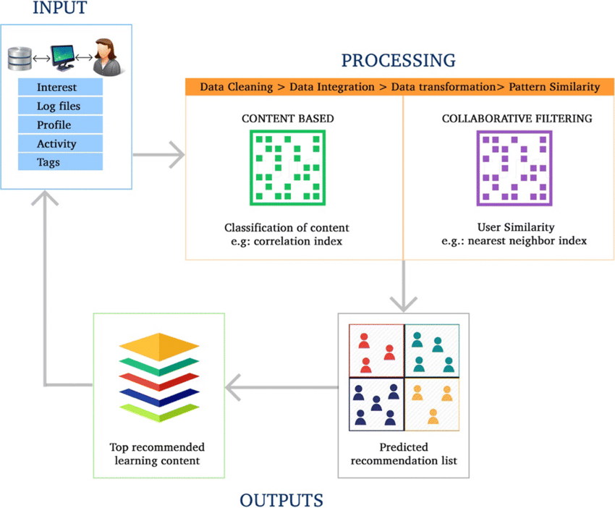
Hybrid recommendation systems
Hybrid recommender system is a special type of recommender system that combines different methods, generally content and collaborative filtering method
Hybrid approaches can be implemented in several ways: by making content based and collaborative based predictions separately and then combining them; by adding content based capabilities to a collaborative based approach (and vice versa)
These methods can also be used to overcome some of the following problems in recommender systems
Avoid the problem of recommending only similar products
Overcome the problem of false nearest neighbors
More personalized recommendations and specific to the user needs
Computationally faster system than the traditional recommendation system algorithms.

Slide 9
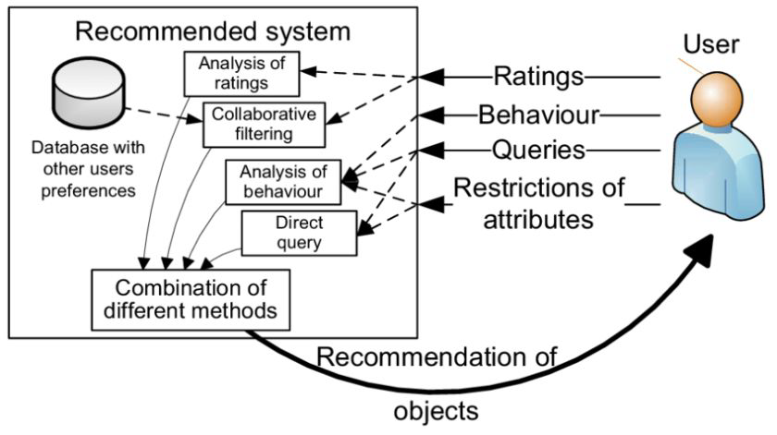
Enhancing User Experience
Personalization: Recommendation systems personalize user
experiences by providing tailored content, products, or
services.
User Engagement: Recommendations can effectively enhance
user engagement and satisfaction, thereby increasing user
retention.
Business Impact: They have significant impact on businesses,
such as increased sales, through effective recommendation
systems.
Credit: Neptune.ai

Slide 10
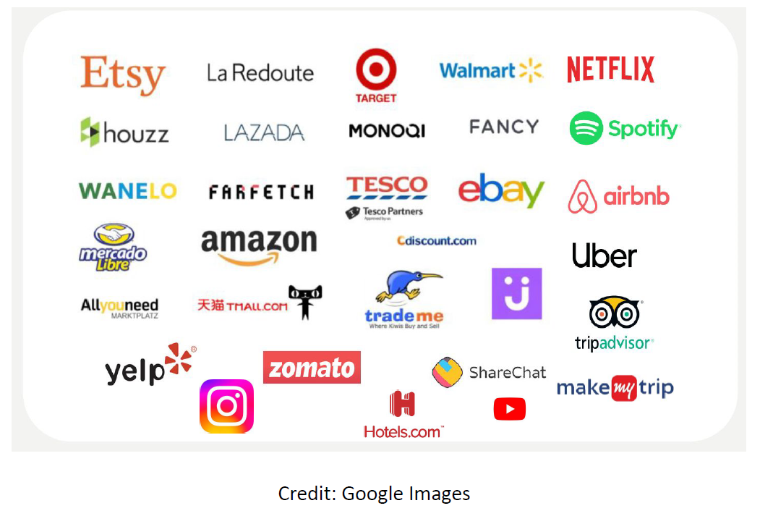
Application of Recommendation Systems

Slide 11
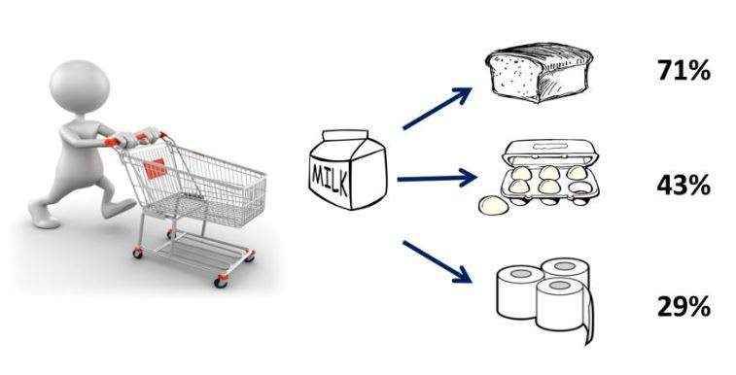
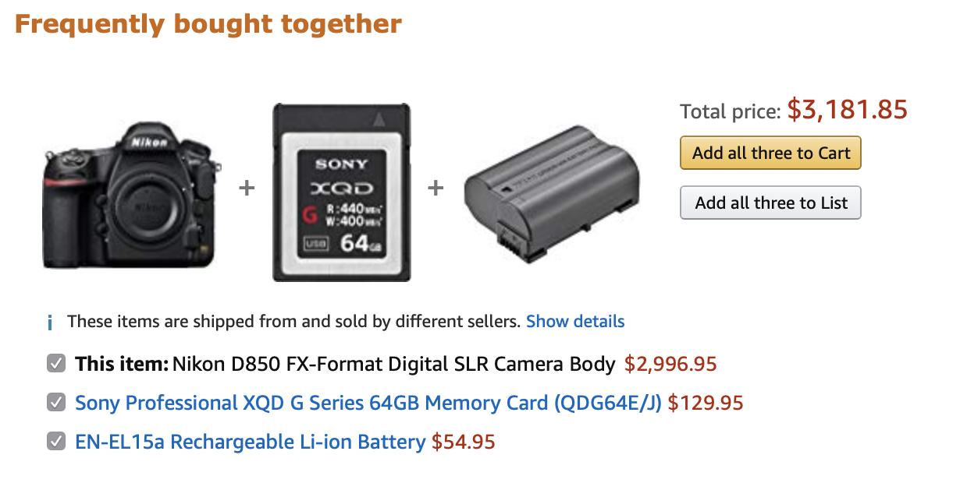
Market Basket Analysis
Market basket analysis is a technique used by companies to increase sales by better understanding customer purchasing patterns.
It takes purchase history data to find product groupings, as well as products that are likely to be purchased together.

Slide 12
Market Basket Analysis
Market basket analysis is a data mining technique used by retailers to increase sales by better understanding customer purchasing patterns. It involves analyzing large data sets, such as purchase history, to reveal product groupings, as well as products that are likely to be purchased together.
It answers questions like:
Which items are frequently bought together?
If a user buys an item X, which item is he/she likely to buy next?

Slide 13
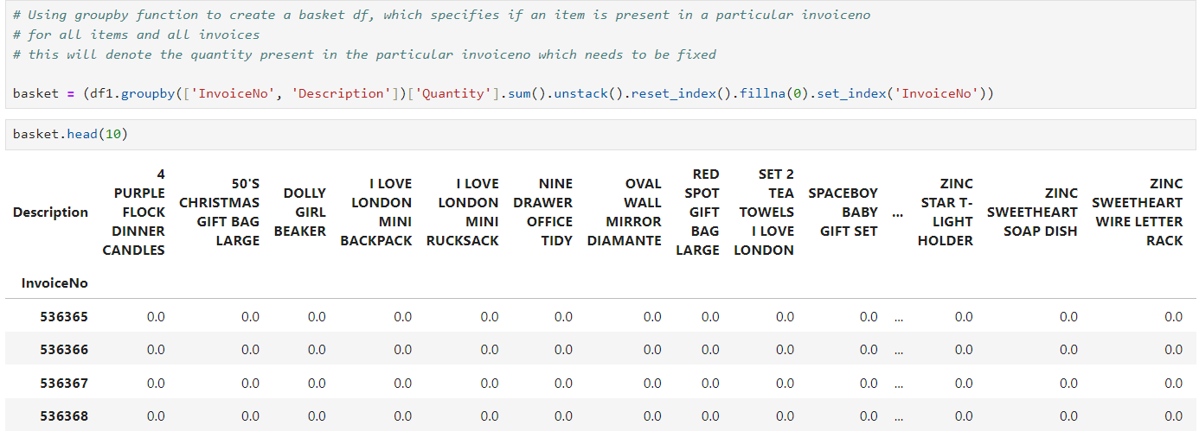
Analysis of Dataset

Slide 14
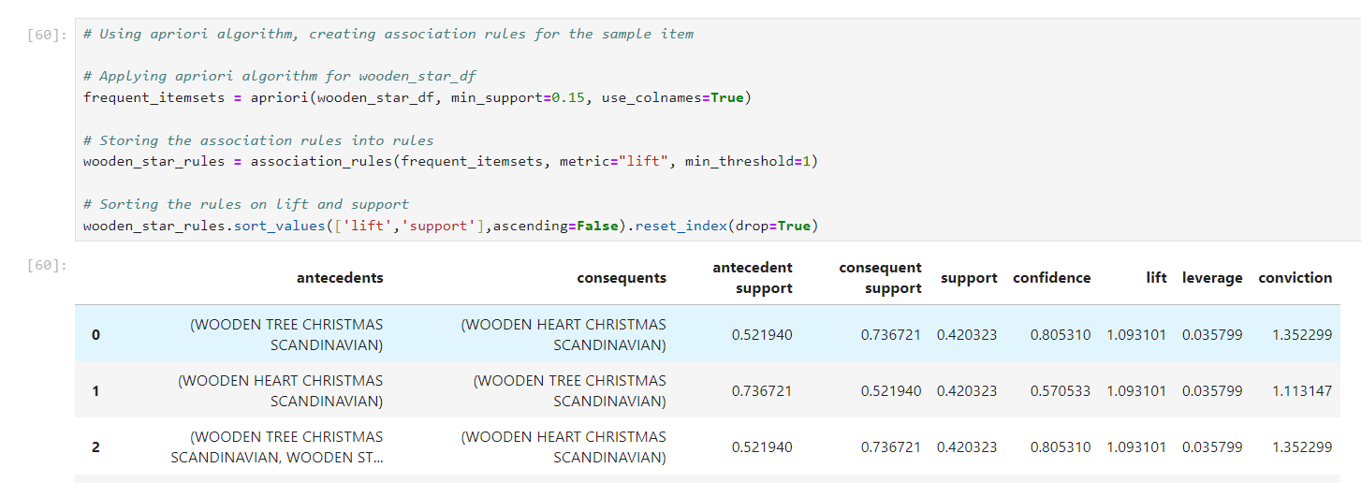
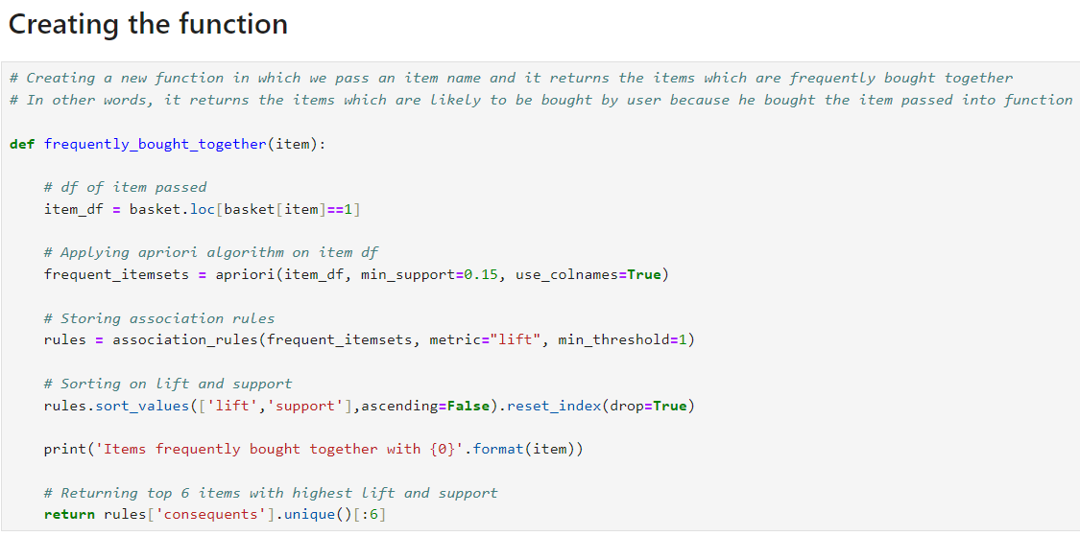

Slide 15
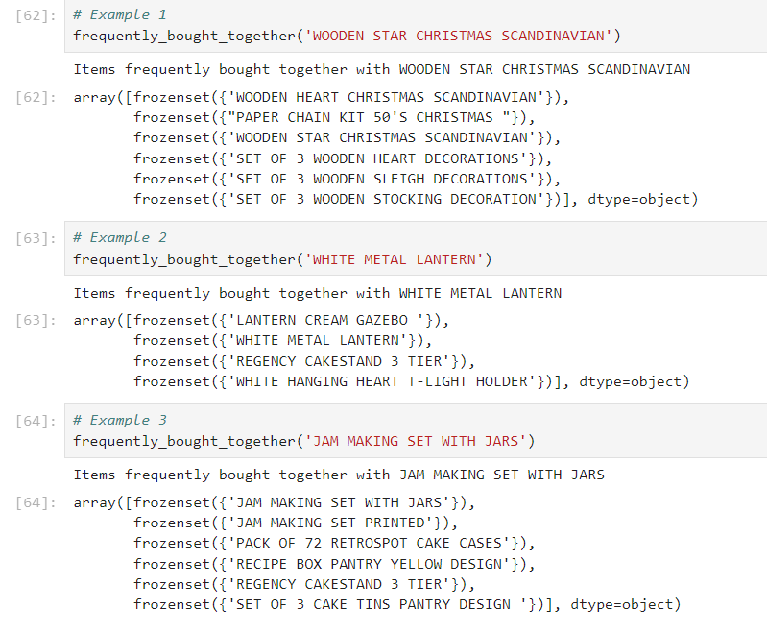

Slide 16


Characteristics of Vector Databases
V
e
c
t
o
r
D
a
t
a
b
a
s
e
Vector
High dimensional vectors
Uses indexing for searching
Compactable with all data formats
Image transformer
[1.2,1.3…0.2,0.1]
Happy Birthday
Text transformer
[0.2,1.9…1.2,1.1]
Audio transformer
[0.5,0.7…1.7,1.5]
Open Source Vector DBs
Chroma
FAISS
Milvus
Audio
Uses embedding techniques and highly indexed features
Quick configuration
Each dimension is specific feature of data object
PINECONE has paid subscription

Slide 17

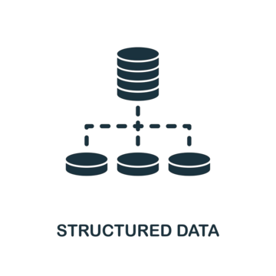
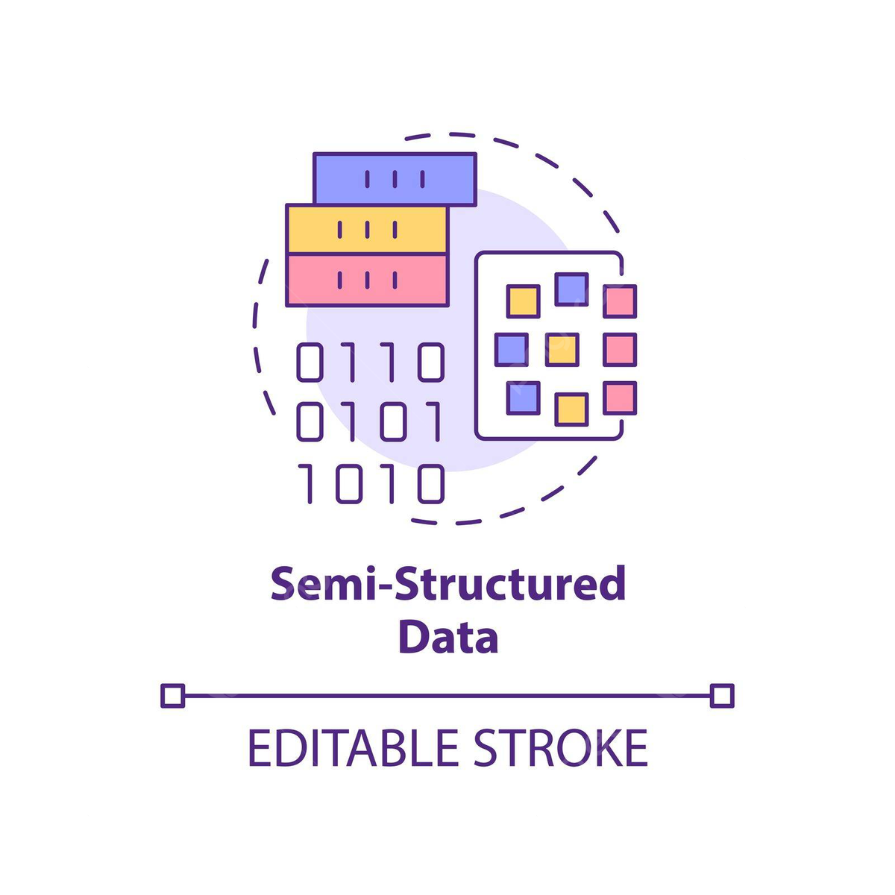

Working Mechanism of Rec System based on Vector DB
Query Result
Query
Application
Post Processing
Structured Text
Embedding
Model
Object as Vector
[1.2,0.3,……,1.4]
Vector Database
Semi Structured Text
Unstructured Text
Data Source

Slide 18
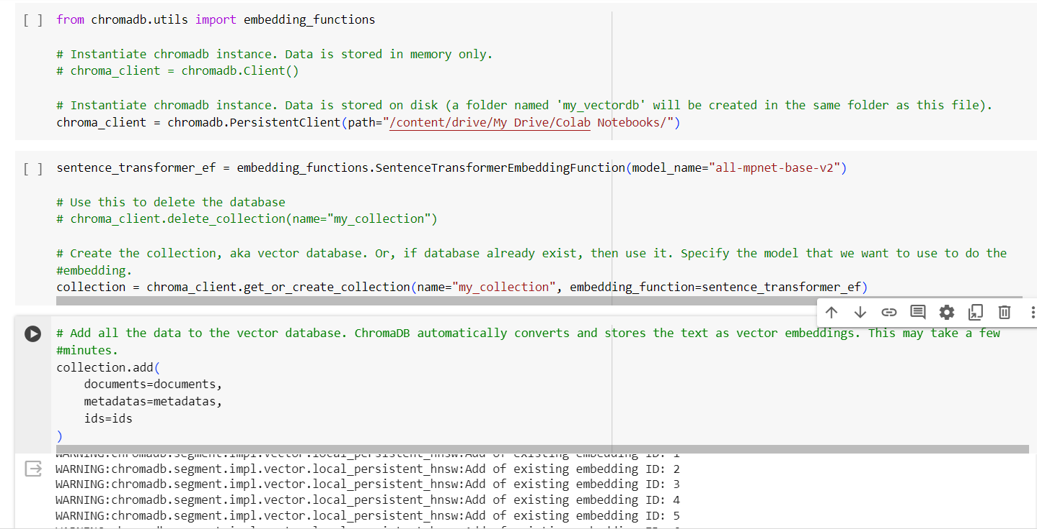

Slide 19
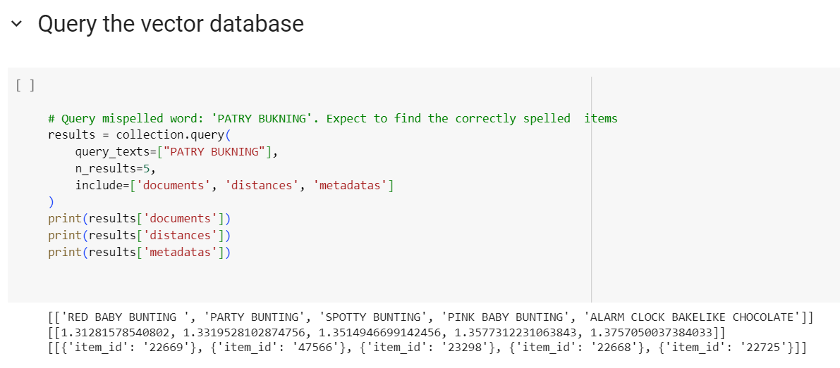

Slide 20
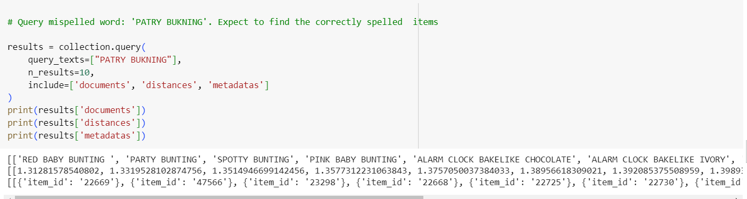
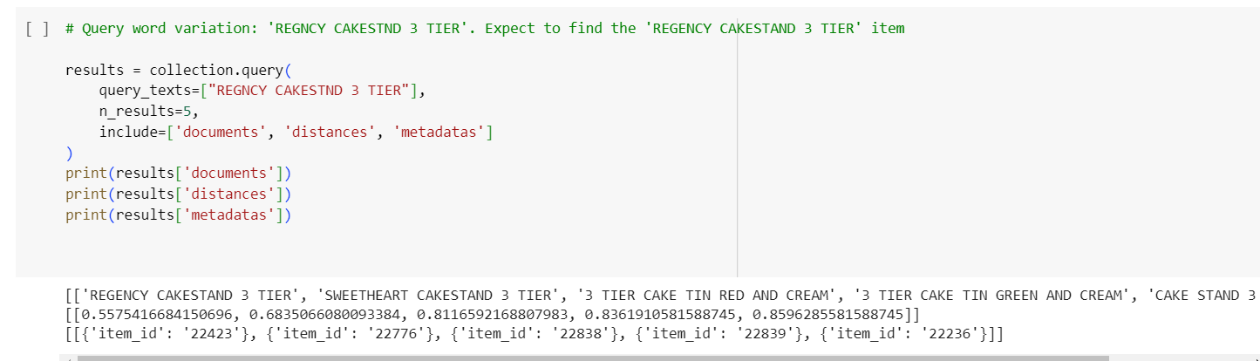

Slide 21
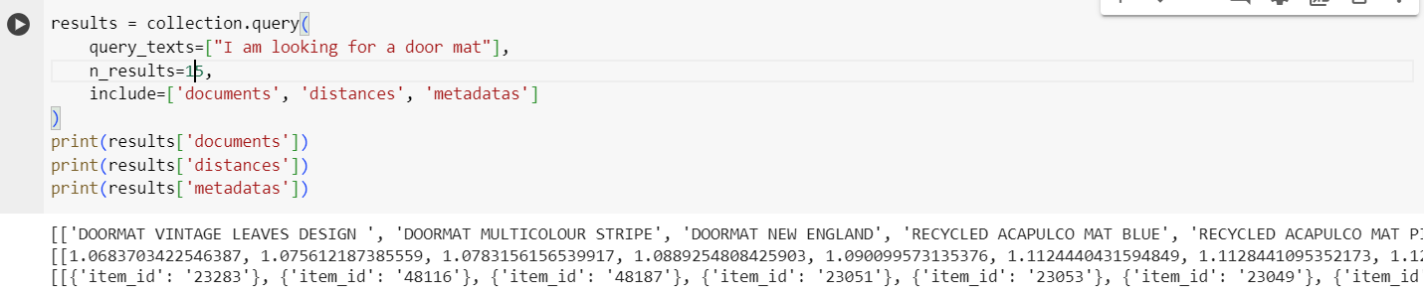
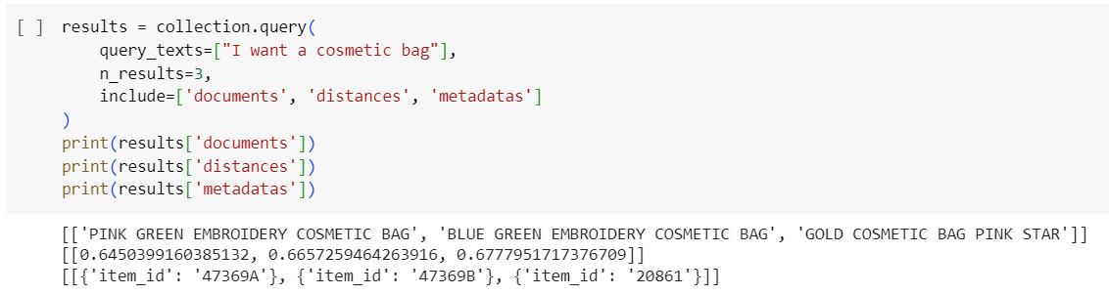

Slide 22
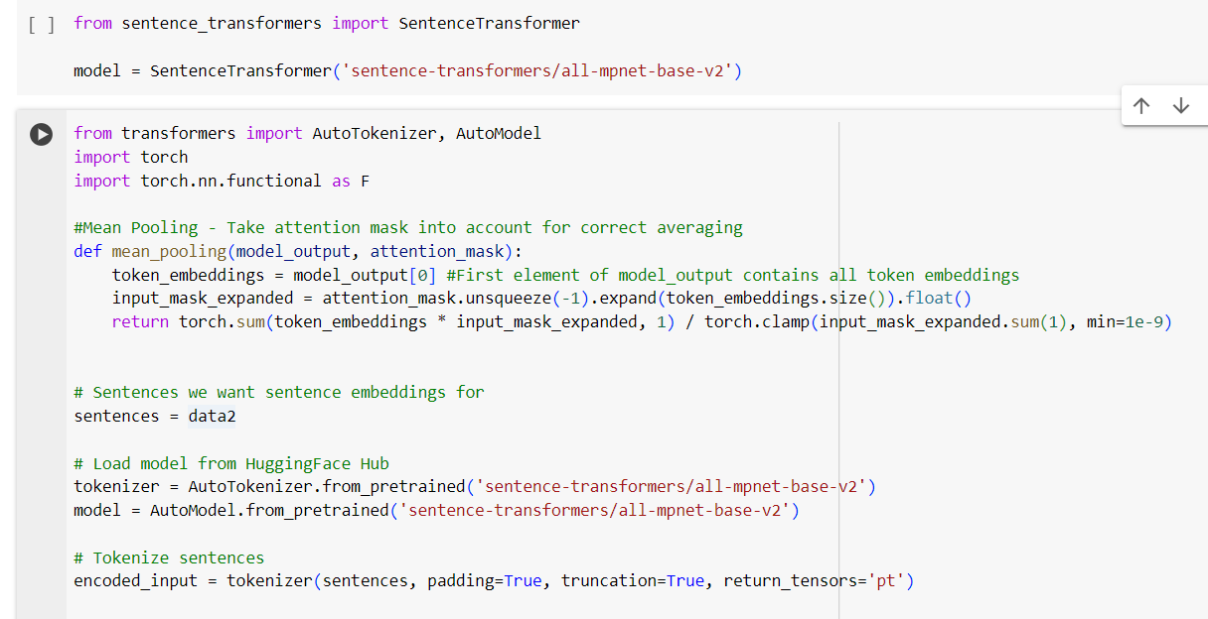

Slide 23
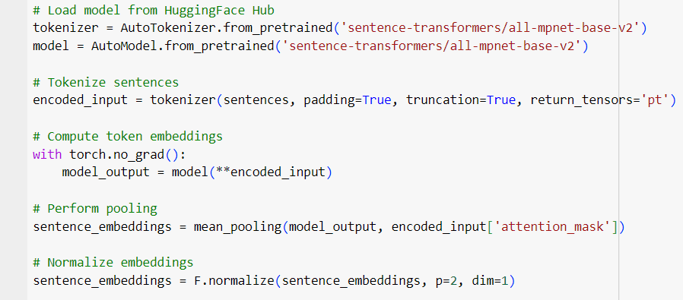
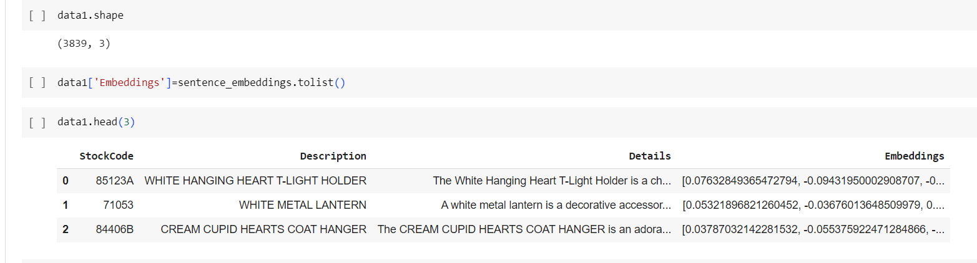

Slide 24
Thank You

